Slide 1
Deep Flaws?

Slide 2

Adversarial?

Slide 3



Adversarial Attack in Deep Learning
Are these the same?
For us, yes, but for deep neural network,

Slide 4
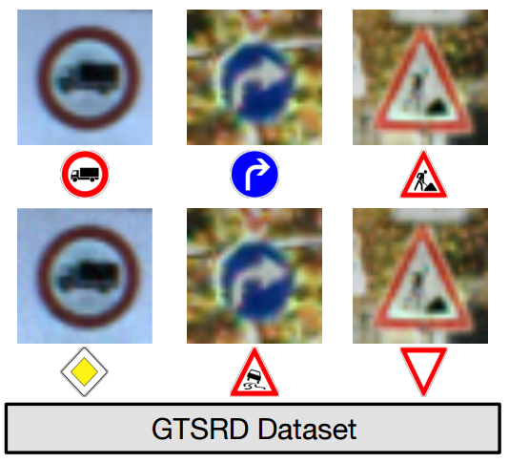
More examples

Slide 5
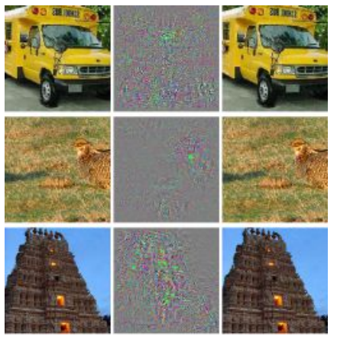
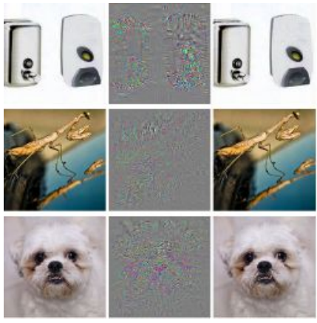
More examples
Correct
Wrong
Correct
Wrong

Slide 6
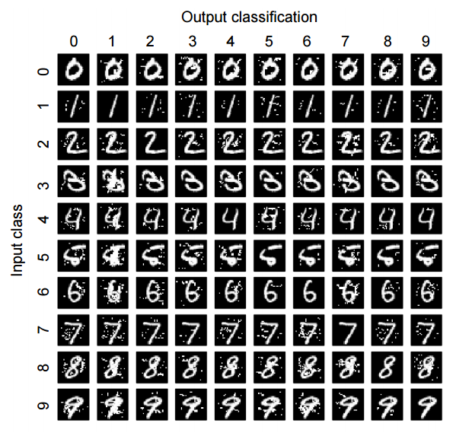
MNIST?

Slide 7
Transferability?
Adversarial examples are known to transfer from one model to another, even if the second model has a different architecture or was trained on a different set.
This cross-model transfer phenomenon enables attackers to control a remotely hosted DNN with no access to the model, its parameters, or its training data
“Practical Black-Box Attacks against Deep Learning Systems using Adversarial Examples”, Arxiv, 2016

